Slide 1
MCIS 3103 - Data Structure and Algorithms Week #07
Fall 2020

Slide 2
Overview
Recursive Function
Binary Tree
Tree Traversal

Slide 3
Functions
Defining a function
Counts the number of occurrences
def count(data, target) – function signature
body of function expressed as an indented block
return statement

Slide 4
Information passing
Parameters
Formal parameter
Actual parameter
prizes = count(grades, A )

Slide 5
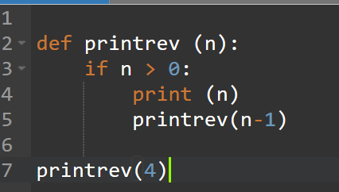
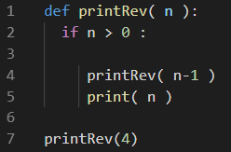
Recursive Function
Recursion: process for solving problems by subdividing a larger problem into smaller cases of the problem itself and the solving the smaller.
Recursive Functions: A function can call any other function, including itself.
Data Structure and Algorithms Using Python-Rance D. Necaise -2011 PP. 277

Slide 6
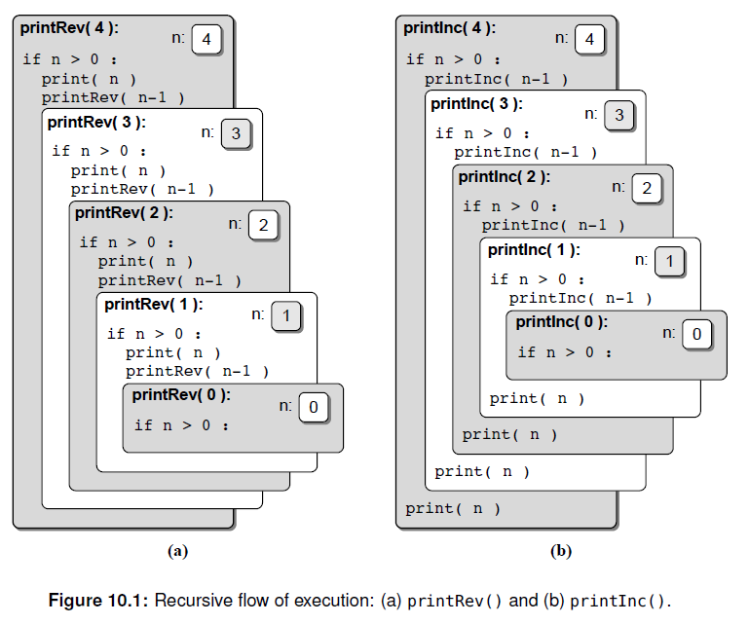
Recursive Function
Data Structure and Algorithms Using Python-Rance D. Necaise -2011 PP. 278

Slide 7

The factorial Function
Recursive implementation
Mathematical example

Slide 8
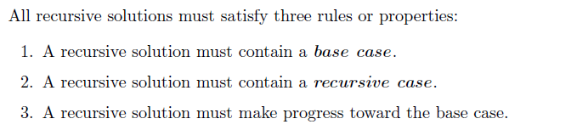
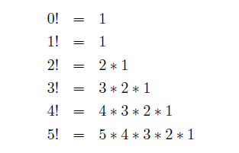
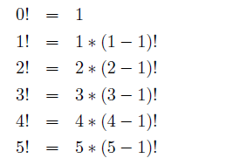
The factorial Function

Slide 9
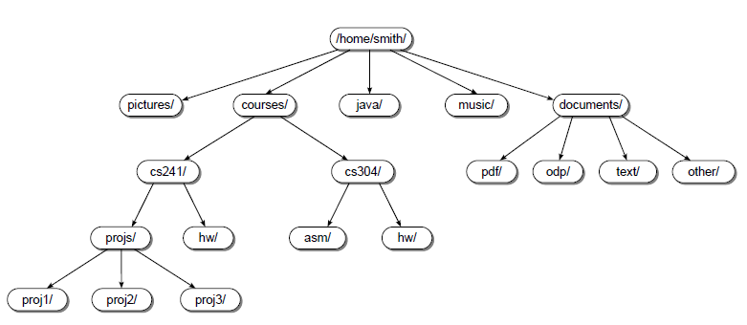
Tree
Tree structure
Examples of tree structure
Data Structure and Algorithms Using Python-Rance D. Necaise -2011 PP. 370

Slide 10
Tree-1
Tree structure
Root : The top most node of the tree
Path: The node encountered when following the edges from a starting node to a destination form a path.
Data Structure and Algorithms Using Python-Rance D. Necaise -2011 PP. 371

Slide 11
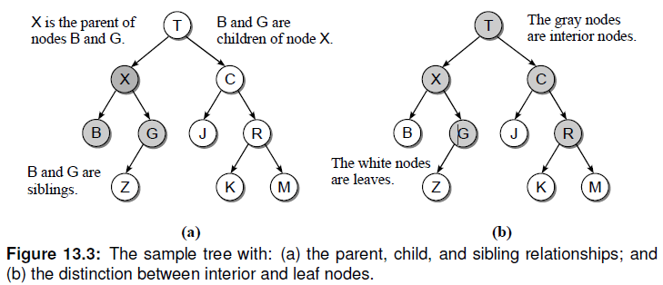
Tree-2
Parents: The organization of the nodes form relationship between the data elements. Every node, except the root, has a parent node.
Children: Each node can have one or more
Data Structure and Algorithms Using Python-Rance D. Necaise -2011 PP. 371

Slide 12
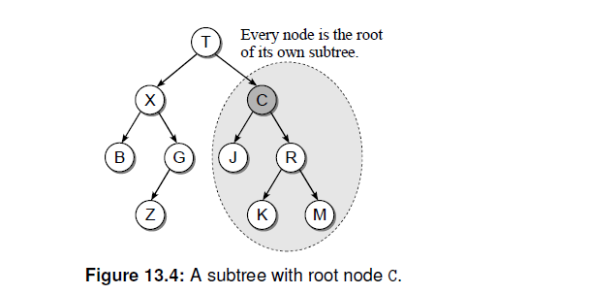
Tree-3
Nodes: Nodes that have at least one child are known as interior nodes while nodes that have no children are known as leaf nodes.
Subtree: Every node can be the root of its own subtree, which consist of a subset of nodes and edges of the larger tree.
Data Structure and Algorithms Using Python-Rance D. Necaise -2011 PP. 372

Slide 13
Binary Tree
A binary tree is a tree in which each node can have at most two children.
One child is identified as the left child and the other as the right child.
Depth: distance from the root, with distance begin the number of levels that separate the two.
Height: number of levels in the tree.
Width: number of nodes on level containing the most nodes.
Data Structure and Algorithms Using Python-Rance D. Necaise -2011 PP. 372

Slide 14
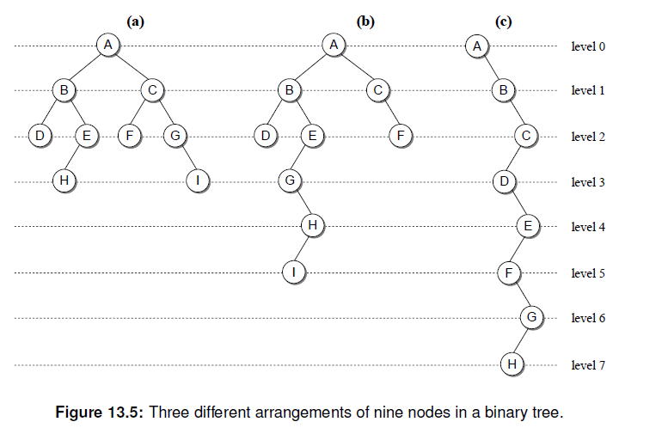
Binary Tree
Depth of ‘G’ in (a) : 2
Height of (c) :
Data Structure and Algorithms Using Python-Rance D. Necaise -2011 PP. 374

Slide 15
Binary Trees
Definition: a binary tree T is either empty or has these properties:
Has a root node
Has two sets of nodes: left subtree L_{T} and right subtree R_{T}
L_{T} and R_{T} are binary trees

Slide 16
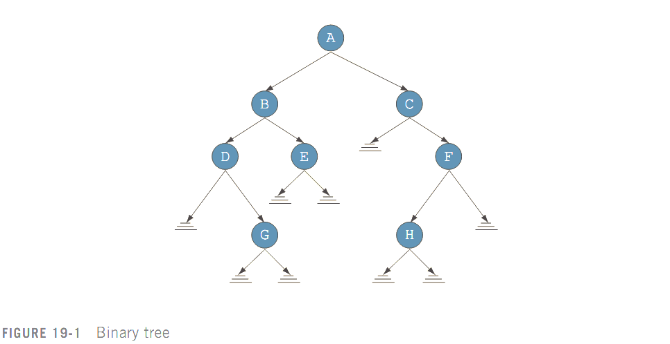
Binary Trees (cont’d.)
Root node, and
parent of B and C
Left child of A
Right child of A
Node
Directed edge,
directed branch, or
branch
Empty subtree
(F’s right subtree)

Slide 17
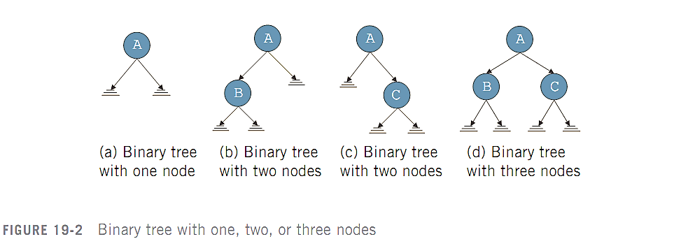
Binary Trees (cont’d.)

Slide 18
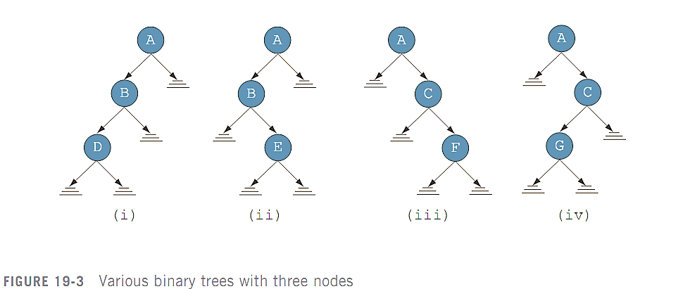
Binary Trees (cont’d.)

Slide 19
Binary Trees (cont’d.)
Every node has at most two children
A node:
Stores its own information
Keeps track of its left subtree and right subtree using pointers
lLink and rLink pointers

Slide 20
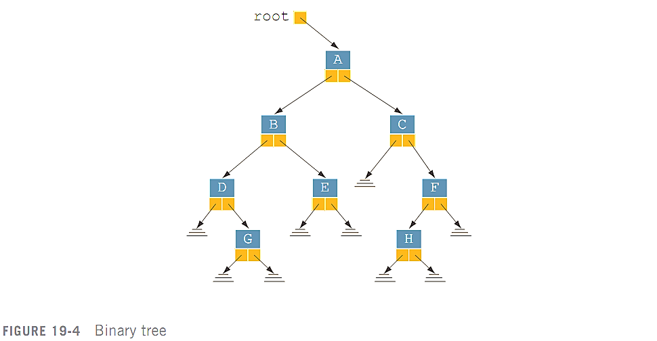
Binary Trees (cont’d.)
A pointer to the root node of the binary tree is stored outside the tree in a pointer variable

Slide 21
Binary Trees (cont’d.)
Leaf: node that has no left and right children
U is parent of V if there is a branch from U to V
There is a unique path from root to every node
Length of a path: number of branches on path
Level of a node: number of branches on the path from the root to the node
Root node level is 0
Height of a binary tree: number of nodes on the longest path from the root to a leaf

Slide 22
Binary Tree Traversal
Insertion, deletion, and lookup operations require traversal of the tree
Must start at the root node
Two choices for each node:
Visit the node first
Visit the node’s subtrees first

Slide 23
Binary Tree Traversal (cont’d.)
Inorder traversal
Traverse the left subtree
Visit the node
Traverse the right subtree
Preorder traversal
Visit the node
Traverse the left subtree
Traverse the right subtree

Slide 24
Binary Tree Traversal (cont’d.)
Postorder traversal
Traverse the left subtree
Traverse the right subtree
Visit the node
Listing of nodes produced by traversal type is called:
Inorder sequence
Preorder sequence
Postorder sequence

Slide 25
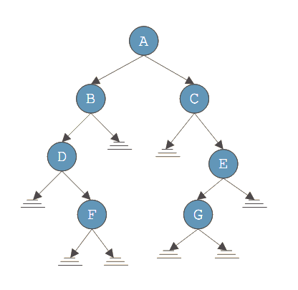
Binary Tree Traversal (cont’d.)
Inorder sequence:
DFBACGE
Preorder sequence:
ABDFCEG
Postorder sequence:
FDBGECA

Slide 26
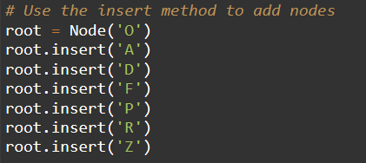
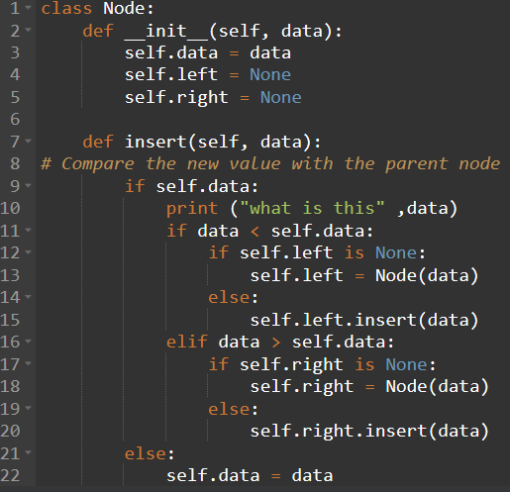
Implementation
O
A
P
D
R
F
Z

Slide 27
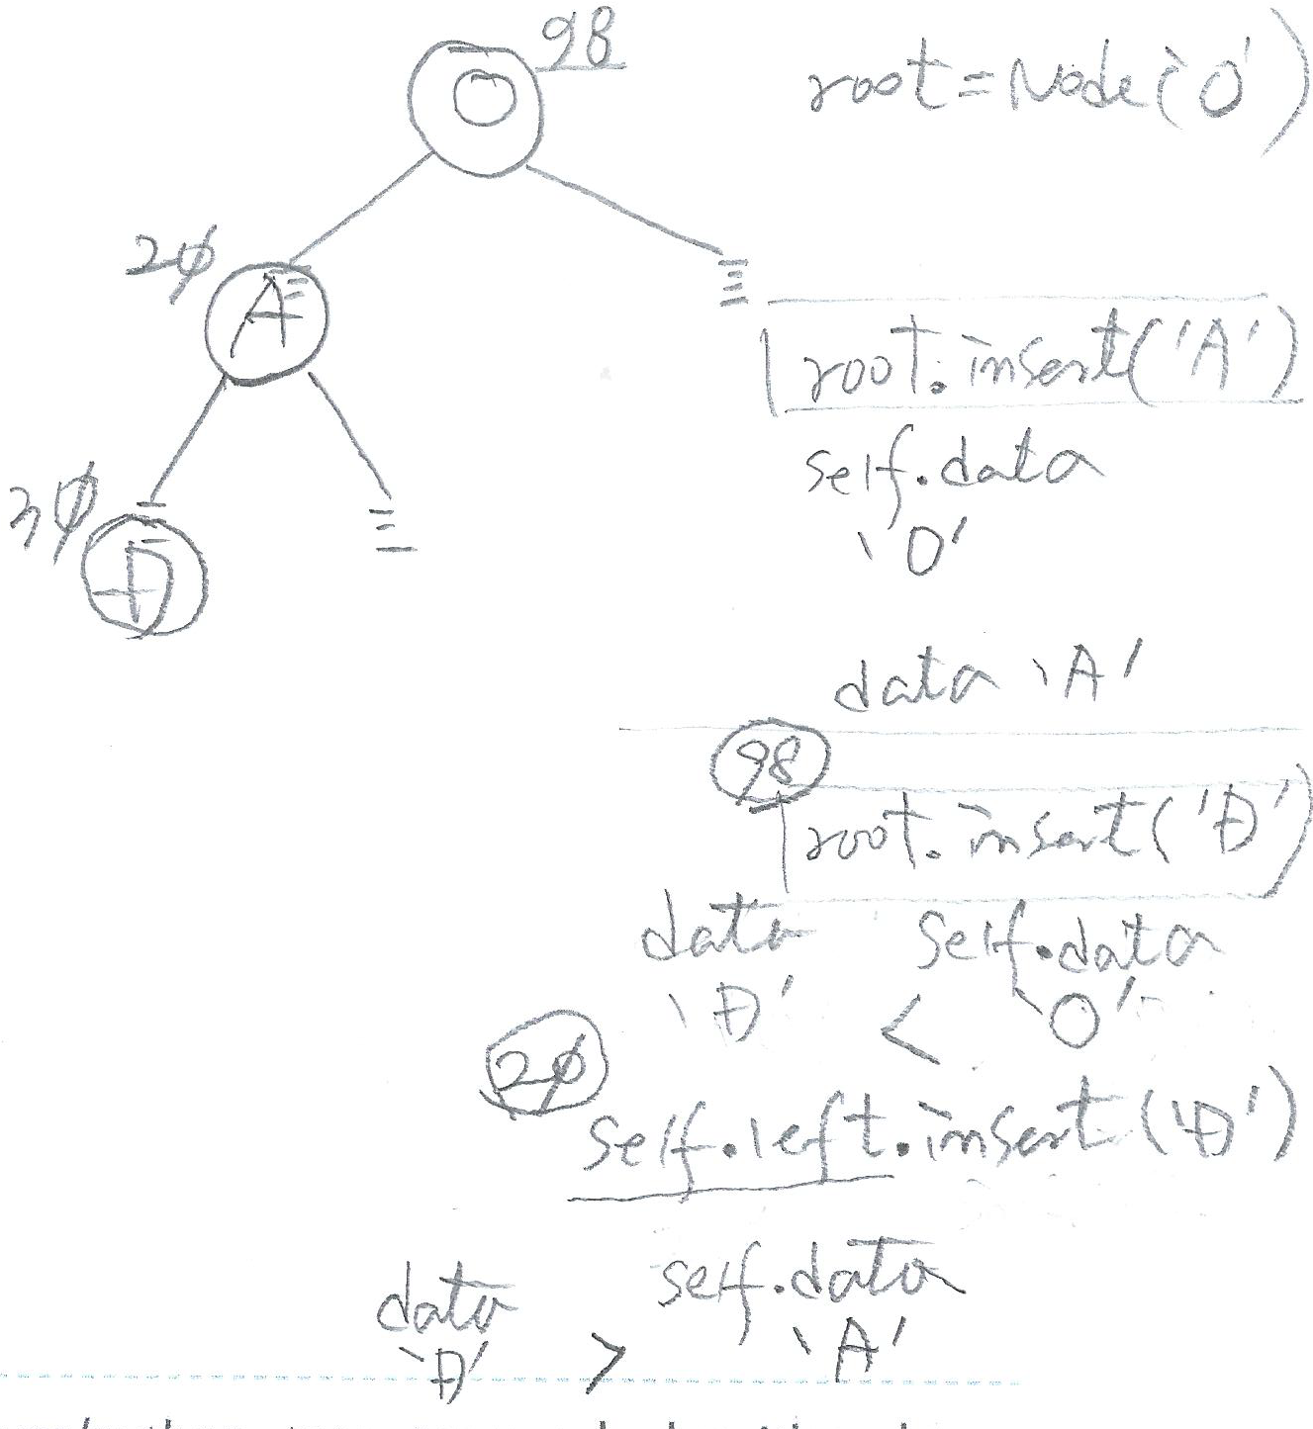
Implementation

Slide 28
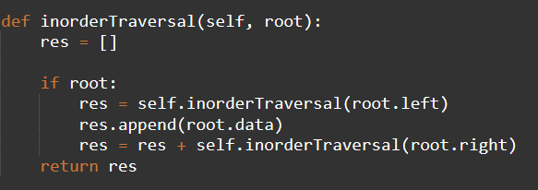
Inorder traversal
O
Inorder => ['A', 'D', 'F', 'O', 'P', 'R', 'Z']
A
P
D
R
F
Z

Slide 29
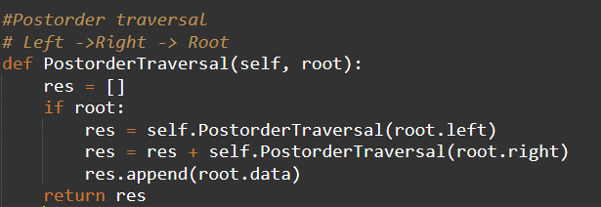
Postorder traversal
O
PostOrder => ['F', 'D', 'A', 'Z', 'R', 'P', 'O']
A
P
D
R
F
Z

Slide 30
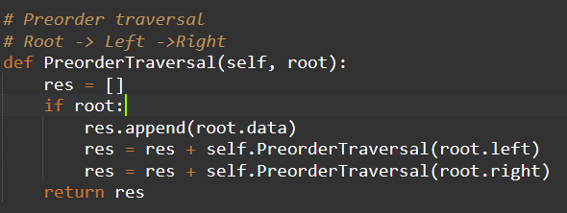
Preorder traversal
O
Preorder => ['O', 'A', 'D', 'F', 'P', 'R', 'Z']
A
P
D
R
F
Z

